Slide 1
Process Synchronization

Slide 2
Cooperating Processes
Independent process cannot affect or be affected by the execution of another process
Cooperating process can affect or be affected by the execution of another process
Advantages of process cooperation
Information sharing
Computation speed-up
Modularity
Convenience

Slide 3
Producer-Consumer Problem
Paradigm for cooperating processes, producer process produces information that is consumed by a consumer process
Example: a print program produces characters that are consumed by printer driver
To run concurrently
unbounded-buffer places no practical limit on the size of the buffer
bounded-buffer assumes that there is a fixed buffer size

Slide 4
Bounded-Buffer – Shared-Memory Solution
Shared data
#define BUFFER_SIZE 10
Typedef struct {
. . .
} item;
item buffer[BUFFER_SIZE];
int in = 0;
int out = 0;
Solution is correct, but can only use BUFFER_SIZE-1 elements

Slide 5
Bounded-Buffer – Producer Process
item nextProduced;
while (1) {
while (((in + 1) % BUFFER_SIZE) == out)
; /* do nothing */
buffer[in] = nextProduced;
in = (in + 1) % BUFFER_SIZE;
}

Slide 6
Bounded-Buffer – Consumer Process
item nextConsumed;
while (1) {
while (in == out)
; /* do nothing */
nextConsumed = buffer[out];
out = (out + 1) % BUFFER_SIZE;
}

Slide 7
Interprocess Communication (IPC)
Mechanism for processes to communicate and to synchronize their actions
Message system – processes communicate with each other without resorting to shared variables
IPC facility provides two operations:
send(message) – message size fixed or variable
receive(message)
If P and Q wish to communicate, they need to:
establish a communication link between them
exchange messages via send/receive
Implementation of communication link
physical (e.g., shared memory, hardware bus)
logical (e.g., logical properties)

Slide 8
Direct Communication
Processes must name each other explicitly:
send (P, message) – send a message to process P
receive(Q, message) – receive a message from process Q
Properties of communication link
Links are established automatically
A link is associated with exactly one pair of communicating processes
Between each pair there exists exactly one link
The link may be unidirectional, but is usually bi-directional

Slide 9
Indirect Communication
Messages are directed and received from mailboxes (also referred to as ports)
Each mailbox has a unique id
Processes can communicate only if they share a mailbox
Properties of communication link
Link established only if processes share a common mailbox
A link may be associated with many processes
Each pair of processes may share several communication links
Link may be unidirectional or bi-directional

Slide 10
Indirect Communication
Operations
create a new mailbox
send and receive messages through mailbox
destroy a mailbox
Primitives are defined as:
send(A, message) – send a message to mailbox A
receive(A, message) – receive a message from mailbox A

Slide 11
Indirect Communication
Mailbox sharing
P₁, P₂, and P₃ share mailbox A
P₁, sends; P₂ and P₃ receive
Who gets the message?
Solutions
Allow a link to be associated with at most two processes
Allow only one process at a time to execute a receive operation
Allow the system to select arbitrarily the receiver. Sender is notified who the receiver was.

Slide 12
Synchronization
Message passing may be either blocking or non-blocking
Blocking is considered synchronous
Blocking send has the sender block until the message is received
Blocking receive has the receiver block until a message is available
Non-blocking is considered asynchronous
Non-blocking send has the sender send the message and continue
Non-blocking receive has the receiver receive a valid message or null

Slide 13
Buffering
Queue of messages attached to the link; implemented in one of three ways
1. Zero capacity – 0 messages Sender must wait for receiver
2. Bounded capacity – finite length of n messages Sender must wait if link full
3. Unbounded capacity – infinite length Sender never waits

Slide 14
Client-Server Communication
Sockets
Remote Procedure Calls
Remote Method Invocation (Java)

Slide 15
Sockets
A socket is defined as an endpoint for communication
Concatenation of IP address and port
The socket 161.25.19.8:1625 refers to port 1625 on host 161.25.19.8
Communication consists between a pair of sockets

Slide 16
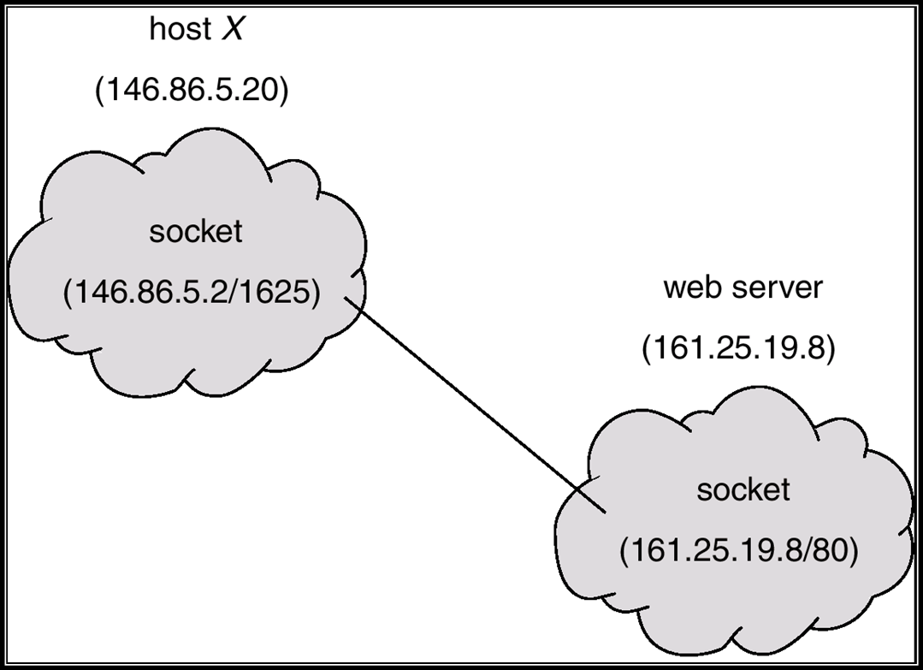
Socket Communication

Slide 17
Remote Procedure Calls
Remote procedure call (RPC) abstracts procedure calls between processes on networked systems.
Stubs – client-side proxy for the actual procedure on the server.
The client-side stub locates the server and marshalls the parameters.
The server-side stub receives this message, unpacks the marshalled parameters, and peforms the procedure on the server.

Slide 18
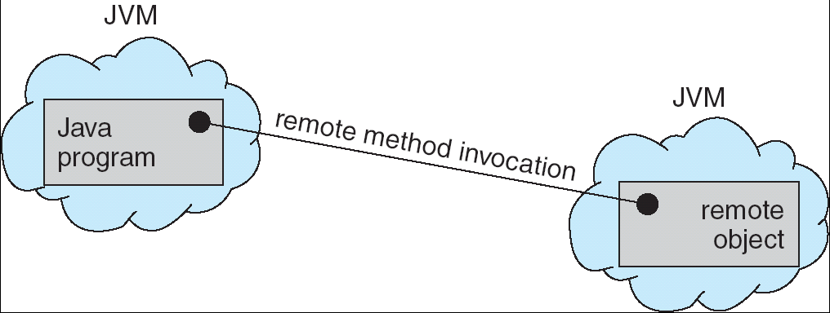
Remote Method Invocation
Remote Method Invocation (RMI) is a Java mechanism similar to RPCs.
RMI allows a Java program on one machine to invoke a method on a remote object.

Slide 19
Background
Concurrent access to shared data may result in data inconsistency
Maintaining data consistency requires mechanisms to ensure the orderly execution of cooperating processes
Suppose that we wanted to provide a solution to the consumer-producer problem that fills all the buffers. We can do so by having an integer count that keeps track of the number of full buffers. Initially, count is set to 0. It is incremented by the producer after it produces a new buffer and is decremented by the consumer after it consumes a buffer.

Slide 20
Producer
while (true)
/* produce an item and put in nextProduced
while (count == BUFFER_SIZE)
; // do nothing
buffer [in] = nextProduced;
in = (in + 1) % BUFFER_SIZE;
count++;
}

Slide 21
Consumer
while (1)
{
while (count == 0)
; // do nothing
nextConsumed = buffer[out];
out = (out + 1) % BUFFER_SIZE;
count--;
/* consume the item in nextConsumed
}

Slide 22
Bounded Buffer
The statements counter++; counter--; must be performed atomically.
Atomic operation means an operation that completes in its entirety without interruption.

Slide 23
Race Condition
count++ could be implemented as register1 = count register1 = register1 + 1 count = register1
count-- could be implemented as register2 = count register2 = register2 - 1 count = register2

Slide 24
Consider this execution interleaving with “count = 5” initially:
S0: producer execute register1 = count {register1 = 5} S1: producer execute register1 = register1 + 1 {register1 = 6} S2: consumer execute register2 = count {register2 = 5} S3: consumer execute register2 = register2 - 1 {register2 = 4} S4: producer execute count = register1 {count = 6 } S5: consumer execute count = register2 {count = 4}
The value of count may be either 4 or 6, where the correct result should be 5.

Slide 25
Critical section
Each process has a segment of code called a critical section, in which the process may change common variables, updating a table, writing a file and so on.
Entry section
Exit section
Remainder section
do
{
Critical section
Remainder section
}
while (1);
entry section
Exit section

Slide 26
Solution to Critical-Section Problem
1. Mutual Exclusion - If process P_{i} is executing in its critical section, then no other processes can be executing in their critical sections
2. Progress - If no process is executing in its critical section and there exist some processes that wish to enter their critical section, then the selection of the processes that will enter the critical section next cannot be postponed indefinitely
3. Bounded Waiting - A bound must exist on the number of times that other processes are allowed to enter their critical sections after a process has made a request to enter its critical section and before that request is granted
Assume that each process executes at a nonzero speed
No assumption concerning relative speed of the N processes

Slide 27
Two Process Solution-Algoritm-1
Two processes are numbered P0 and P1. i.e, Pi and Pj
Algorithm 1
A common integer variable turn initialized to 0 or 1. If turn==i Process Pi is allowed to execute in its critical section.
Disadvantage
does not retain the sufficient information about the state of each process.
For Process Pi
do {
while (turn!=i);
CRITICAL SECTION
turn=j;
REMAINDER SECTION
} while(1);

Slide 28
Algorithm-2
For Process pi
do {
flag[i]=true;
while(flag[j]);
CRITICAL SECTION
flag[i]=false;
REMAINDER SECTION
}while(1)
Disadvantage
mutual exclusion is preserved
progress requirement is not met
t0: P0 sets flag[0]=true
t1:P1 sets flag[1]=true
looping fore-ever

Slide 29
Algorithm-3-Peterson’s Solution
Two process solution
The two processes share two variables:
int turn;
Boolean flag[2]
The variable turn indicates whose turn it is to enter the critical section.
The flag array is used to indicate if a process is ready to enter the critical section. flag[i] = true implies that process P_{i} is ready!

Slide 30
Algorithm for Process P_{i}
do {
flag[i] = TRUE;
turn = j;
while ( flag[j] && turn == j);
CRITICAL SECTION
flag[i] = FALSE;
REMAINDER SECTION
} while (TRUE);

Slide 31
Multiple Process Solution
Bakery Algorithm
Data structures used
Boolean choosing[n];
int number[n]
- intialized to false and 0 respectively
Notations used
(a,b)<(c,d) ifa<c or a==c and b<d
Max(a₀,…a_{n-1)} is a number k,such that k>=a_{i} for i=0,…n-1

Slide 32
do
{
Choosing[i]=true;
Number[i]=max(number[0],number[1],…number[n-1])+1;
Choosing[i]=false;
for(j=0;j<n;j++) {
while(choosing[j]);
while(number[j]!=0)&&(number[j],j)<number[i],i));
}
CRITICAL SECTION
number[i]=0;
REMAINDER SECTIION
}while(1);

Slide 33
Synchronization Hardware
Many systems provide hardware support for critical section code
Uniprocessors – could disable interrupts
Currently running code would execute without preemption
Generally too inefficient on multiprocessor systems
Operating systems using this not broadly scalable
Modern machines provide special atomic hardware instructions
Atomic = non-interruptable
Either test memory word and set value
Or swap contents of two memory words

Slide 34
Synchronization Hardware
Either test memory word and set value
the test-and-set instruction is an instruction used to write to a memory location and return its old value as a single atomic (i.e., non-interruptible) operation.
If multiple processes may access the same memory, and if a process is currently performing a test-and-set, no other process may begin another test-and-set until the first process is done.
Or swap contents of two memory words
swap a special instruction that atomically compares the contents of a memory location to a given value and, if they are the same, modifies the contents of that memory location to a given new value. The result of the operation must indicate whether it performed the substitution

Slide 35
TestAndndSet Instruction
Definition:
boolean TestAndSet (boolean *target)
{
boolean rv = *target;
*target = TRUE;
return rv:
}

Slide 36
Solution using TestAndSet
Shared boolean variable lock., initialized to false.
Solution:
do {
while ( TestAndSet (&lock ))
; /* do nothing
// critical section
lock = FALSE;
// remainder section
} while ( TRUE);

Slide 37
Swap Instruction
Definition:
void Swap (boolean *a, boolean *b)
{
boolean temp = *a;
*a = *b;
*b = temp:
}

Slide 38
Solution using Swap
Shared Boolean variable lock initialized to FALSE; Each process has a local Boolean variable key.
Solution:
do {
key = TRUE;
while ( key == TRUE)
Swap (&lock, &key );
// critical section
lock = FALSE;
// remainder section
} while ( TRUE);

Slide 39
Bounded –waiting mutual exclusion with TestAndSet
do {
waiting[i]=true;
key = true
while (waiting[i])&&key)
key= TestAnd Set(lock);
waiting[i]=false;
}
Critical Section
J=(i+1)%n;
While((j!=i)&&!waiting[j])
J=(j+1)%n;
If(j==i)
Lock=false;
Else
Waiting[j]=false;
Remainder section
}(1)

Slide 40
Semaphore
A semaphore S is an integer variable that apart from initialization is accessed only through two standard atomic operations: wait and signal
Synchronization tool that does not require busy waiting
Semaphore S – integer variable
Two standard operations modify S: wait() and signal()
Originally called P() and V()
Less complicated
Can only be accessed via two indivisible (atomic) operations
wait (S) {
while S <= 0
; // no-op
S--;
}
signal (S) {
S++;
}

Slide 41
Usage
Semaphores can be used to deal with n-process critical section problem
n process share a semaphore, mutex initialized to 1
Provides mutual exclusion
Semaphore S; // initialized to 1
do {
wait (S);
Critical Section
signal (S);
Remainder section
} while(1);

Slide 42
Used to solve various concurrency problems.
Consider two concurrently running process
P1 with statement s1
P2 with statement s2
S2 should be executed only after s1 completes
Implementation
p1 and p2 share a common semaphore synch initialised to 0 and inserting
S1;
Signal(synch);
wait(synch);
s2;
in p1
in p2

Slide 43
Semaphore Implementation with no Busy waiting
Requires Busy waiting
While a process is in its critical section, any other process that tries to enter the critical section must loop continuously in the entry section.
This type of semaphore is called spinlocks.
Solution: modify the definition of wait() and signal() operations.
When a process executes wait operation and finds that semaphore value is not positive, it blocks itself; places the process into waiting queue and changes the status into waiting.
The process should be restarted by a wakeup operation

Slide 44
Implementation
With each semaphore there is an associated waiting queue. Each entry in a waiting queue has two data items:
value (of type integer)
pointer to next record in the list
Two operations:
block – place the process invoking the operation on the appropriate waiting queue.
wakeup – remove one of processes in the waiting queue and place it in the ready queue.

Slide 45

Semaphore Implementation with no Busy waiting (Cont.)
Implementation of wait:
wait (Semaphore S){
S.value--;
if (S.value < 0) {
add this process to waiting queue
block(); }
}
Implementation of signal:
Signal (Semaphore S){
S.value++;
if (S.value <= 0) {
remove a process P from the waiting queue
wakeup(P); }
}

Slide 46
Semaphore Implementation
Must guarantee that no two processes can execute wait () and signal () on the same semaphore at the same time
Thus, implementation becomes the critical section problem where the wait and signal code are placed in the crtical section.
Could now have busy waiting in critical section implementation
But implementation code is short
Little busy waiting if critical section rarely occupied
Note that applications may spend lots of time in critical sections and therefore this is not a good solution.

Slide 47
Semaphore as General Synchronization Tool
Counting semaphore – integer value can range over an unrestricted domain
Binary semaphore – integer value can range only between 0 and 1; can be simpler to implement
Also known as mutex locks
Can implement a counting semaphore S as a binary semaphore

Slide 48
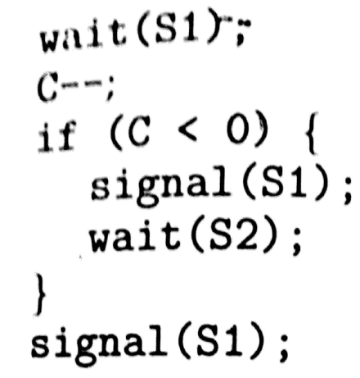
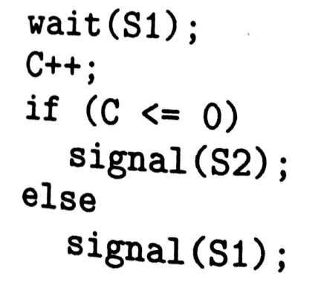
Binary Semaphore
Let S be a counting semaphoe
To implement it in binary semaphore
Binary-semaphore s1,s2;
Int c;
S1=1,s2=0
C=Value of S
Wait
Signal

Slide 49
Deadlock and Starvation
Deadlock – two or more processes are waiting indefinitely for an event that can be caused by only one of the waiting processes
Let S and Q be two semaphores initialized to 1
P₀ P₁
wait (S); wait (Q);
wait (Q); wait (S);
. .
. .
. .
signal (S); signal (Q);
signal (Q); signal (S);
Starvation – indefinite blocking. A process may never be removed from the semaphore queue in which it is suspended.

Slide 50
Classical Problems of Synchronization
Bounded-Buffer Problem
Readers and Writers Problem
Dining-Philosophers Problem

Slide 51
Bounded-Buffer Problem
N buffers, each can hold one item
Semaphore mutex initialized to the value 1
Semaphore full initialized to the value 0
Semaphore empty initialized to the value N.

Slide 52
Bounded Buffer Problem (Cont.)
The structure of the producer process
do {
// produce an item
wait (empty);
wait (mutex);
// add the item to the buffer
signal (mutex);
signal (full);
} while (true);

Slide 53
Bounded Buffer Problem (Cont.)
The structure of the consumer process
do {
wait (full);
wait (mutex);
// remove an item from buffer
signal (mutex);
signal (empty);
// consume the removed item
} while (true);

Slide 54
Readers-Writers Problem
A data set is shared among a number of concurrent processes
Readers – only read the data set; they do not perform any updates
Writers – can both read and write.
Problem – allow multiple readers to read at the same time. Only one single writer can access the shared data at the same time.
Shared Data
Data set
Semaphore mutex initialized to 1.
Semaphore wrt initialized to 1.
Integer readcount initialized to 0.

Slide 55
Readers-Writers Problem (Cont.)
The structure of a writer process
do {
wait (wrt) ;
// writing is performed
signal (wrt) ;
} while (true)

Slide 56
Readers-Writers Problem (Cont.)
The structure of a reader process
do {
wait (mutex) ;
readcount ++ ;
if (readercount == 1) wait (wrt) ;
signal (mutex)
// reading is performed
wait (mutex) ;
readcount - - ;
if readcount == 0) signal (wrt) ;
signal (mutex) ;
} while (true)

Slide 57
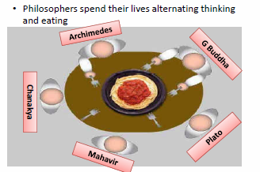
Dining-Philosophers Problem
Shared data
Bowl of rice (data set)
Semaphore chopstick [5] initialized to 1

Slide 58
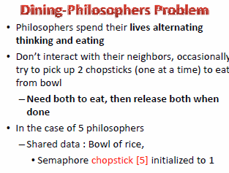

Slide 59
Dining-Philosophers Problem (Cont.)
The structure of Philosopher i:
Do {
wait ( chopstick[i] );
wait ( chopStick[ (i + 1) % 5] );
// eat
signal ( chopstick[i] );
signal (chopstick[ (i + 1) % 5] );
// think
} while (true) ;

Slide 60
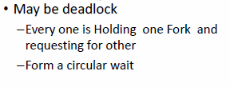
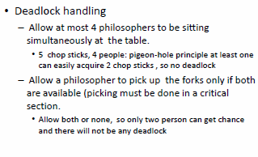
Problems & Solutions

Slide 61
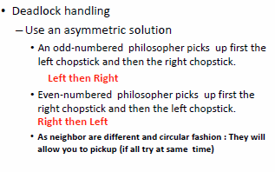

Slide 62
Problems with Semaphores
Incorrect use of semaphore operations:
signal (mutex) …. wait (mutex)
wait (mutex) … wait (mutex)
Omitting of wait (mutex) or signal (mutex) (or both)
Deadlocks / Starvation

Slide 63
Monitors
A high-level abstraction that provides a convenient and effective mechanism for process synchronization
Only one process may be active within the monitor at a time
monitor monitor-name
{
// shared variable declarations
procedure P1 (…) { …. }
…
procedure Pn (…) {……}
Initialization code ( ….) { … }
…
}
}

Slide 64
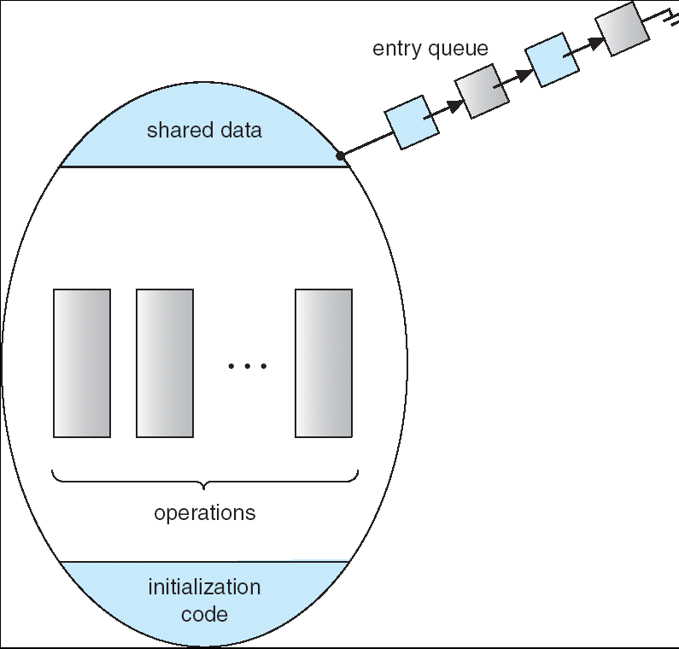
Schematic view of a Monitor

Slide 65
Condition Variables
condition x, y;
Two operations on a condition variable:
x.wait () – a process that invokes the operation is
suspended.
x.signal () – resumes one of processes (if any) tha
invoked x.wait ()

Slide 66
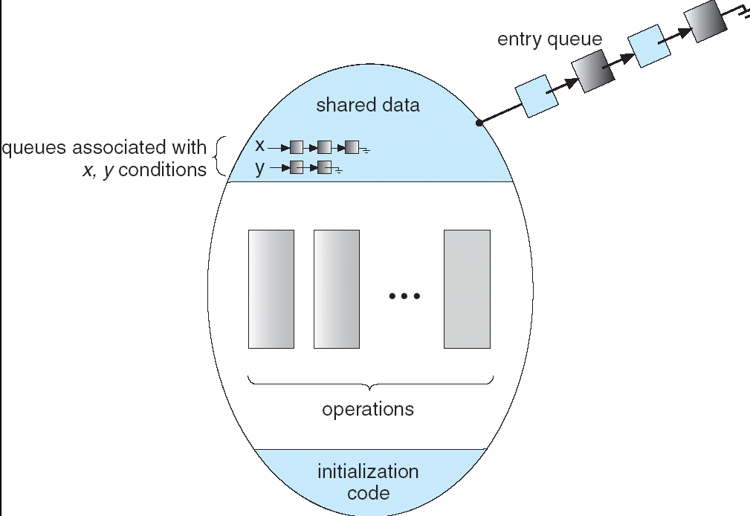
Monitor with Condition Variables

Slide 67
Solution to Dining Philosophers
monitor DP
{
enum { THINKING; HUNGRY, EATING) state [5] ;
condition self [5];
void pickup (int i) {
state[i] = HUNGRY;
test(i);
if (state[i] != EATING) self [i].wait;
}
void putdown (int i) {
state[i] = THINKING;
// test left and right neighbors
test((i + 4) % 5);
test((i + 1) % 5);
}

Slide 68
Solution to Dining Philosophers (cont)
void test (int i) {
if ( (state[(i + 4) % 5] != EATING) &&
(state[i] == HUNGRY) &&
(state[(i + 1) % 5] != EATING) ) {
state[i] = EATING ;
self[i].signal () ;
}
}
initialization_code() {
for (int i = 0; i < 5; i++)
state[i] = THINKING;
}
}

Slide 69
Solution to Dining Philosophers (cont)
Each philosopher i invokes the operations pickup()
and putdown() in the following sequence:
dp.pickup (i)
EAT
dp.putdown (i)

